Slide 1

Delta Hotel
Project Semester II
Year 1
www.DeltaHotel.com
Delta Hotel
Group Four (CP200801-M)
Notes:
Group Four

Slide 2
Group Designer
Delta Hotel
Group Four Members
Group Leader : Tran The Khai (CP200703-M17)
Member : Le Hoai Thuong (CP200701-F04)
Member : Phan Thi Thuy Trang (CP200801-M06)
  Project Name: DeltaHotel.
  Duration Working: (08/9/2008) to (08/11/2008)
Group Four (CP200801-M)
Notes:
Group Four

Slide 3
Approved Teacher
Delta Hotel
Teacher : Tran Thi Hong An
  Teacher of Can Tho University (CUSC)
Group Four (CP200801-M)

Slide 4
Contents
Delta Hotel
1.
Introduction About Group
2.
Problem Definition
3.
Process Design Document
4.
CRS/Customer Acceptance Criteria
Group Four (CP200801-M)
Notes:
Group Four

Slide 5
Contents(Cont)
Delta Hotel
5.
Project plan
6.
GUI Standards Document
7.
Interface Design Document
8.
Flow of The Application
Group Four (CP200801-M)

Slide 6
Contents(Cont)
Delta Hotel
9.
E-R Diagram
10.
Database Design Table
11.
Algorithms
12.
Coding Standards Document
Group Four (CP200801-M)

Slide 7
Contents(Cont)
Delta Hotel
13.
Task Sheet
14.
Testing Document
15.
Project Review
16.
Final Check List
Group Four (CP200801-M)

Slide 8
Tran The Khai (CP200703-M17)
Delta Hotel
1
Form 1: Problem Definition
2
Form 6: Table Design
3
3
Form 6: E R Diagram
4
4
Flow of The Application
Group Four (CP200801-M)

Slide 9
Tran The Khai (CP200703-M17)(Cont)
Delta Hotel
5
Food & Buffet Algorithms
6
Booking Buffet Algorithms
3
7
Buffet Order Algorithms
3
8
Bill Buffet Algorithms
Group Four (CP200801-M)

Slide 10
Problem Definition
Delta Hotel
Can Tho DeltaHotel Resort has some problem with the system:
  It’s too slow to know free room.
  Cost a lot of time check bill.
  Cost a lot of papers to save imformation of guest check in and check out.
An automated system is necessary to solve above difficulties.
  A consistency database.
  Automatic check free room.
  Automatic calculate money for room and other services.
Group Four (CP200801-M)

Slide 11
Table Design
Delta Hotel
Name of the Table | Name of Fields | Type of Fields | Type Size | Constraints | Description
Login | UserName | varchar | 50 | Primary Key | Content information of user and Administration
 | FullName | varchar | 50 | Allow Null
 | Address | varchar | 50 | Allow Null
 | Phone | varchar | 20 | Allow Null
 | Permission | bit | 1 | Not null
 | Password | varchar | 50 | Not null
Group Four (CP200801-M)

Slide 12
Table Design(Cont)
Delta Hotel
Name of the Table | Name of Fields | Type of Fields | Type Size | Constraints | Description
Room | Room_ID | varchar | 10 | Primary Key | Content information of rooms
 | Room_TypeID | varchar | 10 | Foreign key
 | Name_Room | varchar | 20 | Allow null
 | Price | money | 8 | Allow null
 | Description | nvarchar | 500 | Allow null
 | No_fo_bed | int | 4 | Not null
 | Room_Status | bit | 1 | Not null
Group Four (CP200801-M)

Slide 13
Table Design(Cont)
Delta Hotel
Name of the Table | Name of Fields | Type of Fields | Type Size | Constraints | Description
RoomType | Room_TypeID | Varchar | 10 | Primary Key | Content Type of room
 | Room_type_Name | Varchar | 20 | Not null
Foods | Food_ID | int | 4 | Primary Key | Content name of foods, country, type of foods
 | Name_Food | nvarchar | 50 | Allow null
 | Country_Food | varchar | 50 | Allow null
 | Type_Food | varchar | 50 | Allow null
 | Kind_Food | varchar | 50 | Allow null
Group Four (CP200801-M)

Slide 14
Table Design(Cont)
Delta Hotel
Name of the Table | Name of Fields | Type of Fields | Type Size | Constraints | Description
Customer | Customer_ID | bigint | 8 | Primary Key | Content information of customers
 | Customer_Name | varchar | 50 | Not null
 | Customer_Address | varchar | 50 | Allow null
 | Customer_Phone | varchar | 50 | Allow null
 | Customer_Gender | bit | 1 | Allow null
 | Date_of_Birth | varchar | 50 | Allow null
 | Customer_Passpor | bigint | 8 | Allow null
Group Four (CP200801-M)

Slide 15
Table Design(Cont)
Delta Hotel
Name of the Table | Name of Fields | Type of Fields | Type Size | Constraints | Description
Buffet | Buffet_ID | int | 4 | Primary Key | Content information of buffets
 | Type_Buffet | varchar | 50 | Allow null
 | Status | char | 10 | Allow null
 | Price | money | 8 | Not null
 | Buffet_Date | datetime | 8 | Not null
BufferDetails | Buffet_ID | int | 4 | Primary Key | Content Food ID & Buffet ID
 | Food_ID | int | 4 | Allow null
Group Four (CP200801-M)

Slide 16
Table Design(Cont)
Delta Hotel
Name of the Table | Name of Fields | Type of Fields | Type Size | Constraints | Description
Booking_ Details | Booking_ID | Bigint | 8 | Foreign key | Content information about booking room
 | Checkin_Date | datetime | 8 | Not null
 | Chechout_Date | datetime | 8 | Not null
 | Room_ID | varchar | 10 | Foreign key
Booking_ Rooms | Booking_ID | bigint | 8 | Primary Key | Content about date booking room
 | Customer_ID | bigint | 8 | Foreign key
 | Booking_Date | datetime | 8 | Allow null
Group Four (CP200801-M)

Slide 17
Table Design(Cont)
Delta Hotel
Name of the Table | Name of Fields | Type of Fields | Type Size | Constraints | Description
Booking_ Buffet | BB_ID | int | 4 | Primary Key | Content information of booking buffets.
 | Buffet_ID | int | 4 | Foreign key
 | Customer_ID | bigint | 8 | Foreign key
 | Eating_date | datetime | 8 | Not null
 | BB_Date | datetime | 8 | Not null
 | Payment | char | 50 | Not null
 | Amount | int | 4 | Not null
Group Four (CP200801-M)

Slide 18
Table Design(Cont)
Delta Hotel
Name of the Table | Name of Fields | Type of Fields | Type Size | Constraints | Description
BillFoods | BillBuffet_ID | bigint | 8 | Primary Key | Content information of check bills.
 | BB_ID | int | 4 | Not null
 | Total_Pay | money | 8 | Not null
 | Bill_Date | datetime | 8 | Not null
Group Four (CP200801-M)

Slide 19
Table Design(Cont)
Delta Hotel
Name of the Table | Name of Fields | Type of Fields | Type Size | Constraints | Description
Bill_Rooms | Bill_Rooms | bigint | 8 | Primary Key | Content the information of check bill room
 | Booking_ID | bigint | 8 | Allow null
 | Bil_Dates | datetime | 8 | Allow null
 | Room_ID | varchar | 10 | Allow null
 | Room_Type | varchar | 20 | Allow null
 | Price | money | 8 | Allow null
 | Checkin_Date | datetime | 8 | Allow null
 | Chechout_Date | datetime | 8 | Allow null
 | Total_Pay | money | 8 | Allow null
Group Four (CP200801-M)

Slide 20
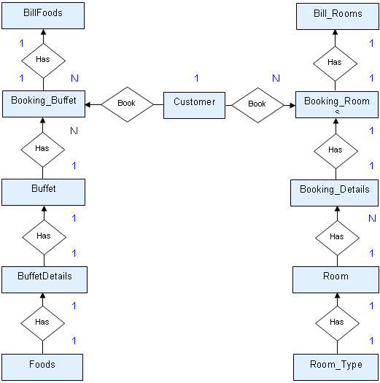
ER Diagram
Delta Hotel
Group Four (CP200801-M)

Slide 21
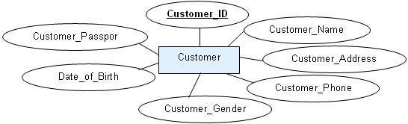
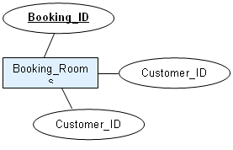
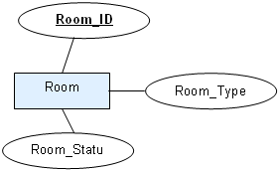
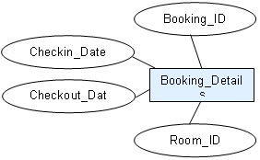
ER Diagram(Cont)
Delta Hotel
Group Four (CP200801-M)

Slide 22
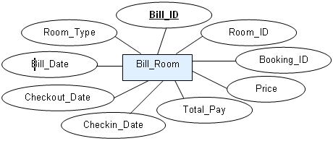
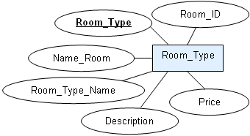
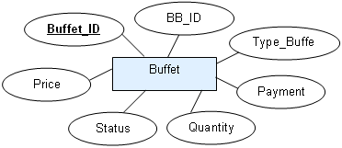
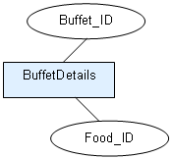
ER Diagram(Cont)
Delta Hotel
Group Four (CP200801-M)

Slide 23
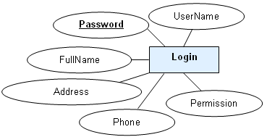
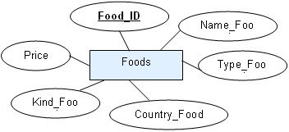
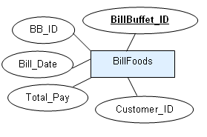
ER Diagram(Cont)
Delta Hotel
Group Four (CP200801-M)

Slide 24
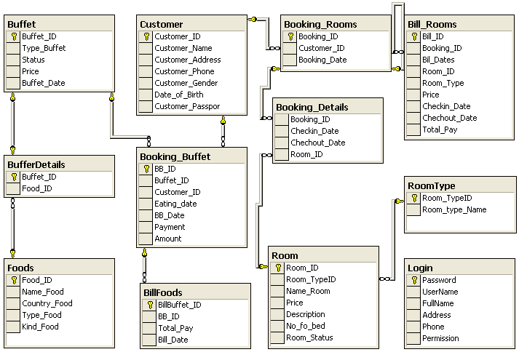
ER Diagram(Cont)
Delta Hotel
Group Four (CP200801-M)

Slide 25
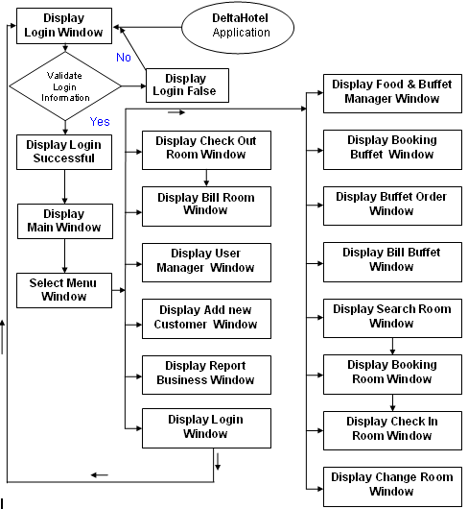
Flow of The Application
Delta Hotel
Group Four (CP200801-M)

Slide 26
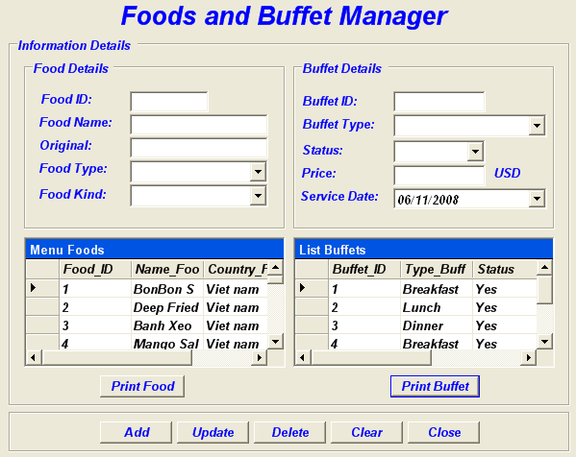
Food & Buffet Form
Delta Hotel
Group Four (CP200801-M)

Slide 27
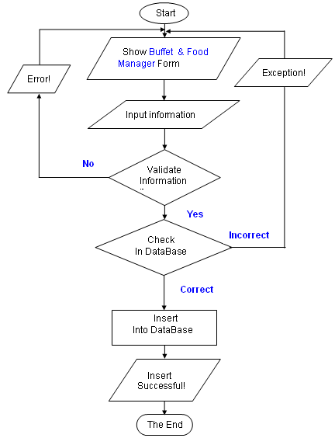
Add Food & Buffet Algorithms
Delta Hotel
Group Four (CP200801-M)

Slide 28
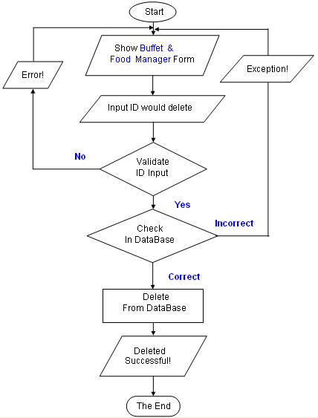
Delete Food & Buffet Algorithms(Cont)
Delta Hotel
Group Four (CP200801-M)

Slide 29
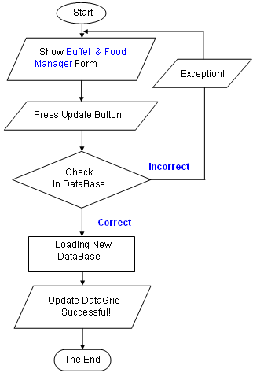
Update Food & Buffet Algorithms(Cont)
Delta Hotel
Group Four (CP200801-M)

Slide 30
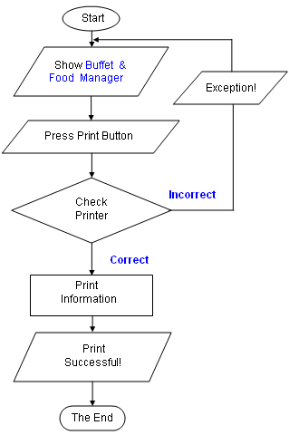
Print Food & Buffet Algorithms(Cont)
Delta Hotel
Group Four (CP200801-M)

Slide 31
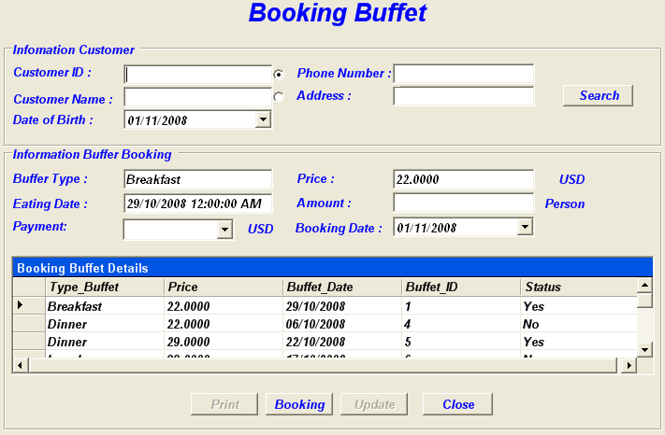
Form Booking Buffet
Delta Hotel
Group Four (CP200801-M)

Slide 32
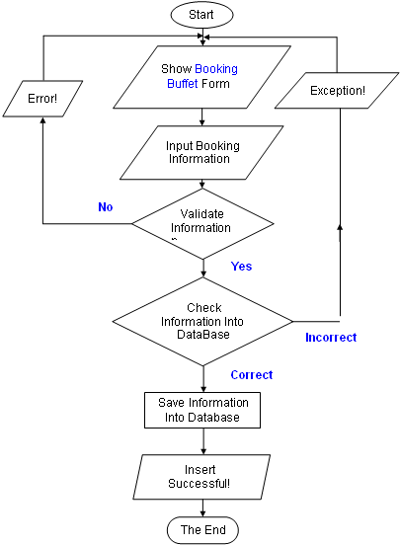
Booking Buffet Algorithm
Delta Hotel
Group Four (CP200801-M)

Slide 33
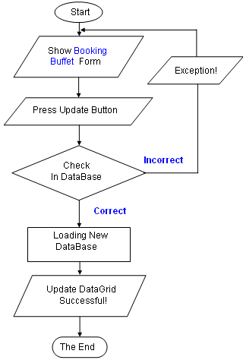
Update Booking Buffet Algorithm
Delta Hotel
Group Four (CP200801-M)

Slide 34
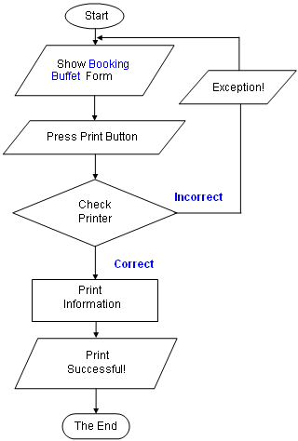
Print Booking Buffet Algorithm
Delta Hotel
Group Four (CP200801-M)

Slide 35
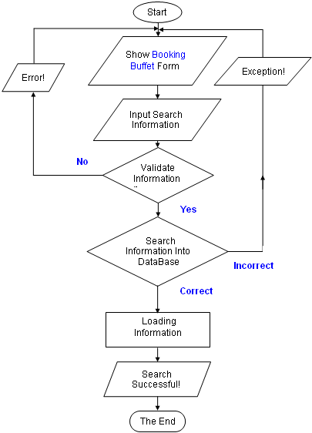
Search Booking Buffet Algorithm
Delta Hotel
Group Four (CP200801-M)

Slide 36
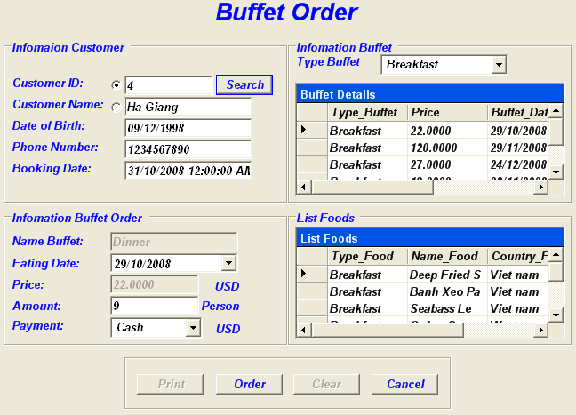
Form Buffet Order
Delta Hotel
Group Four (CP200801-M)

Slide 37
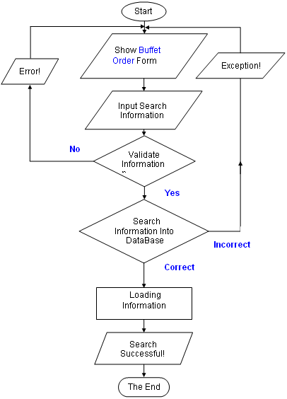
Search Buffet Order Algorithm
Delta Hotel
Group Four (CP200801-M)

Slide 38
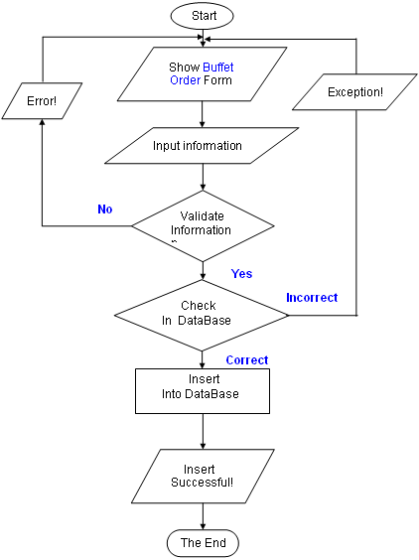
Buffet Order Algorithm
Delta Hotel
Group Four (CP200801-M)

Slide 39
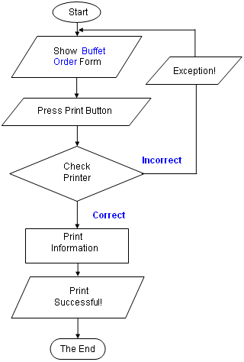
Print Buffet Order Algorithm
Delta Hotel
Group Four (CP200801-M)

Slide 40
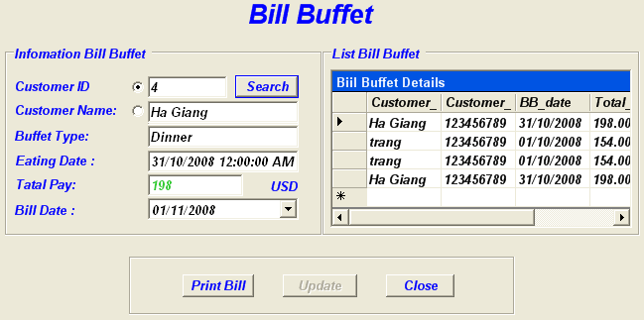
Form Bill Buffet
Delta Hotel
Group Four (CP200801-M)

Slide 41
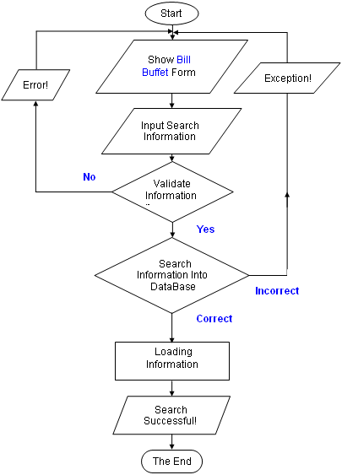
Search Bill Buffet Algorithm
Delta Hotel
Group Four (CP200801-M)

Slide 42
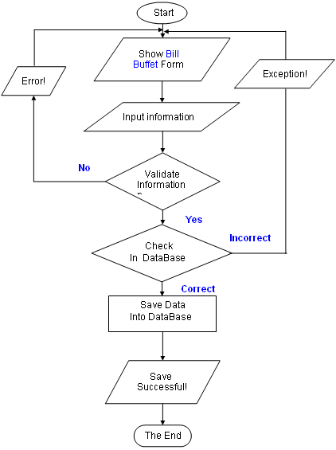
Save Bill Buffet Algorithm
Delta Hotel
Group Four (CP200801-M)

Slide 43
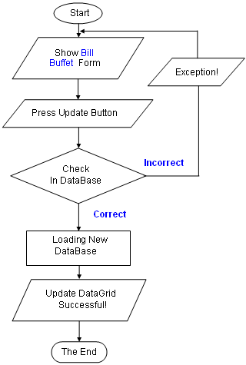
Update DataGrid Bill Buffet algorithm
Delta Hotel
Group Four (CP200801-M)

Slide 44
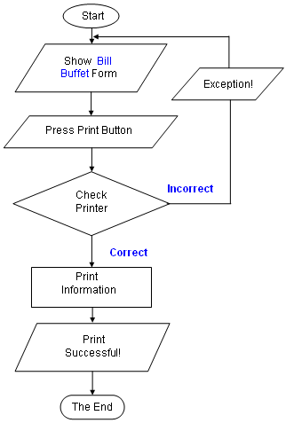
Print Bill Buffet Algorithm
Delta Hotel
Group Four (CP200801-M)

Slide 45
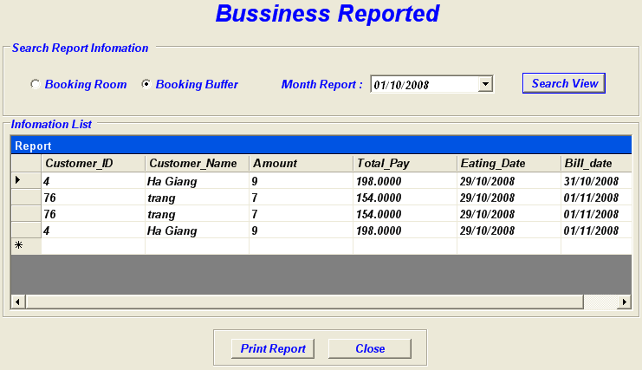
Form Bussiness Report
Delta Hotel
Group Four (CP200801-M)

Slide 46
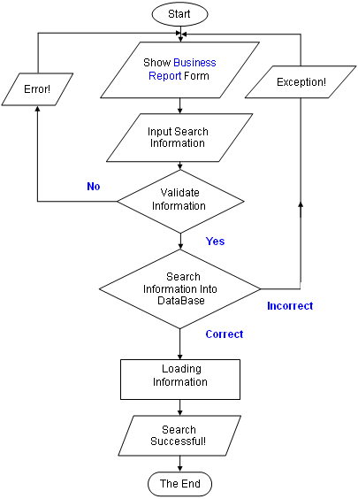
Search Business Report Algorithm
Delta Hotel
Group Four (CP200801-M)

Slide 47
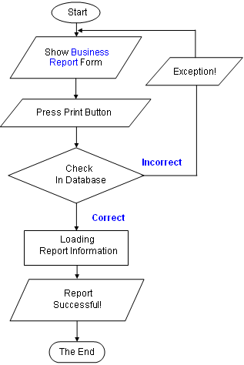
Print Business Report algorithm
Delta Hotel
Group Four (CP200801-M)

Slide 48
Phan Thi Thuy Trang (CP200801-M06)
Delta Hotel
1
Project Plan
2
CheckOut Algorithm
3
3
Login Algorithmt
4
4
User manager Algorithmt
5
Add New Customer Algorithm
Group Four (CP200801-M)

Slide 49
Project Plan
Delta Hotel
Project Details:
  Name of the Client : DeltaHotel
  Release Date : 08-11-2008
  Project Vision/Objectives :
    A consistency database.
    Automatic check free room.
    Automatic calculate money for room and other services.
Scope:
  Functions:
  - Easy to use booking system, list buffet orders ,cancellation of orders,check bills.
  - Manager room.
  - Handle information and give out customer information.
  - Handle food, buffet and other services to customer.
  - Print food menu, bill, and report.
Group Four (CP200801-M)

Slide 50
Project Plan(Cont)
Delta Hotel
  The process in the application have:
  - SearchRoom: Reception give the information of the room of the customer need and the application will show the searching result.
  - Manage Room: you can add new, modify room (with status of each room).
  - Manage Food: you can add new, modify or delete food type, food list.
  - Print bill when customer checkout and pay.
  - Print report.
  + For security, the application ask management their management’s account and password, and limit user roles.
  - Aministration: have full powers, can create and delete acount.
  - Reception or other employee: can do(insert, delete, and update): manage and search room, room type,chang password, room booking; add, search customer; order buffet, services; give out bill, accept payment
Group Four (CP200801-M)

Slide 51
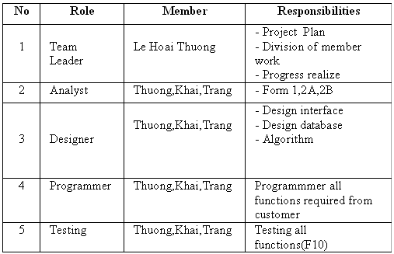
Project Plan(Cont)
Delta Hotel
Our understanding of the client organization.
  Catering services such as room, buffet …
  Receive the information from customers
  Process room booking and buffet booking
  Bill generation for customers
Project Organization with Responsibilities and Authorities :
Group Four (CP200801-M)

Slide 52
Project Plan(Cont)
Delta Hotel
  2. Project initiation / Requirement Documents:
    The documents which Client apply to help his system manage information about :
    Room.
    Buffet.
    Check bill.
    Print report.
    Customer information.
  3. Deliverables:
    The documents to be handed over to the Client:
    - Designer Document
    - Installation Manual
    - User Manual
    - Maintenance Manual
    - Code documents
Group Four (CP200801-M)

Slide 53
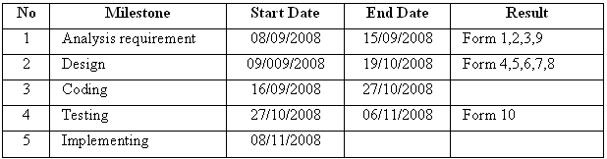
Project Plan(Cont)
Delta Hotel
4. Project Dependencies:
  Customer change requirement.
  More requests but do not give more time.
  System have some problems.
  Members in group disagree about database, and interface forms.
5. Major Project Milestones :
Group Four (CP200801-M)

Slide 54
Project Plan(Cont)
Delta Hotel
6. Quality Plan :
  ◘ Review Activities (Review meeting participants, frequency)
  Meeting twice a week to discuss.
  ◘ Testing Activities (Final Test)
  Unit Testing
  Intergradations Testing
  Functional Testing
  User Testing
  ◘ Backup and recovery strategies (in case of disk crash, network failures)
  Data assurance , must be copy after each modifies .
  Data will be saved in DVD everyday.
  The newest of update .
  Anti virues.
Group Four (CP200801-M)

Slide 55
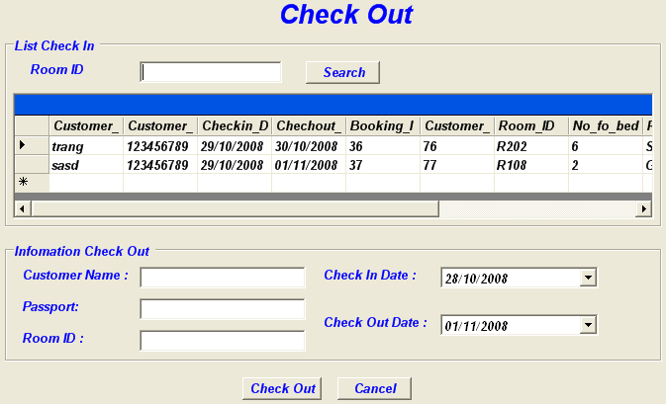
From check out
Delta Hotel
Group Four (CP200801-M)

Slide 56
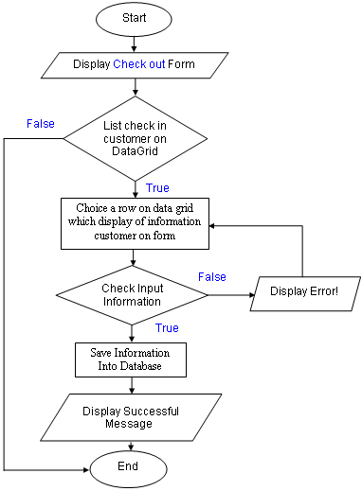
CheckOut Algorithm
Delta Hotel
Group Four (CP200801-M)

Slide 57
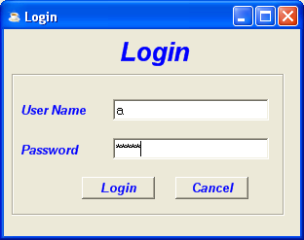
Login form
Delta Hotel
Group Four (CP200801-M)

Slide 58
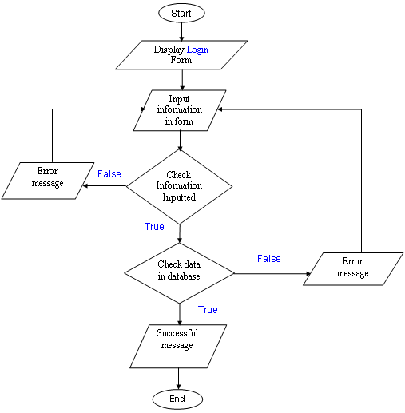
Login Algorithmt
Delta Hotel
Group Four (CP200801-M)

Slide 59
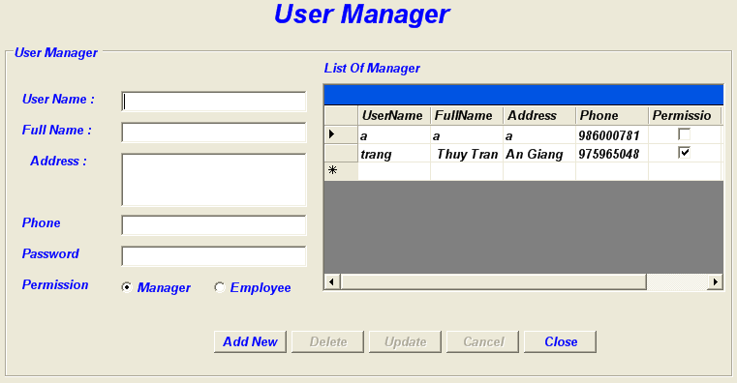
Form User manager
Delta Hotel
Group Four (CP200801-M)

Slide 60
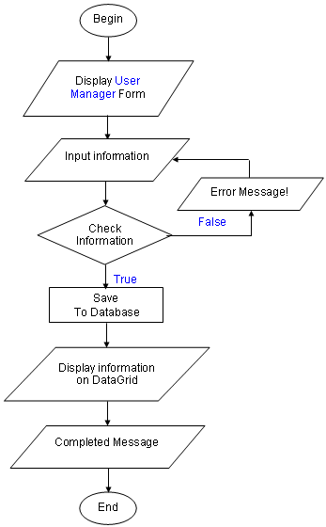
Add New Algorithmt
Delta Hotel
Group Four (CP200801-M)

Slide 61
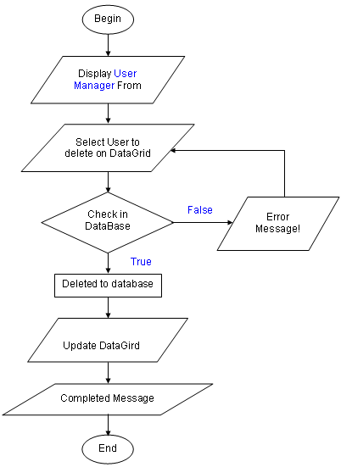
Delete Algorithmt
Delta Hotel
Group Four (CP200801-M)

Slide 62
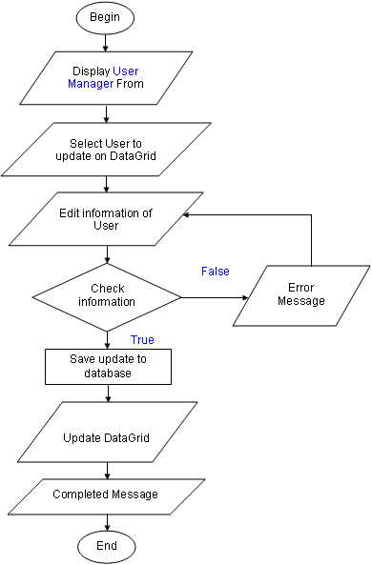
Update Algorithm
Delta Hotel
Group Four (CP200801-M)

Slide 63
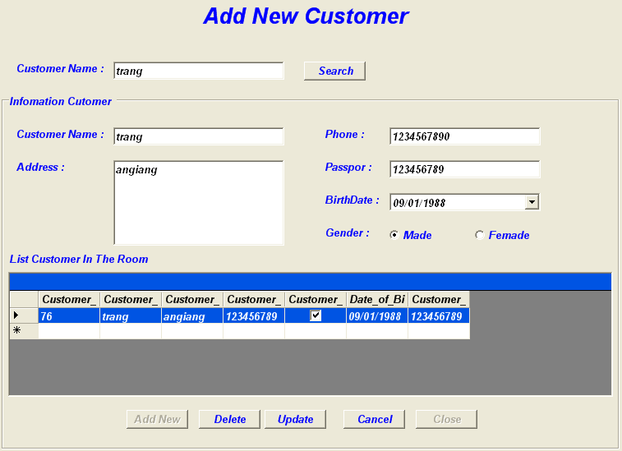
Form Add new Customer
Delta Hotel
Group Four (CP200801-M)

Slide 64
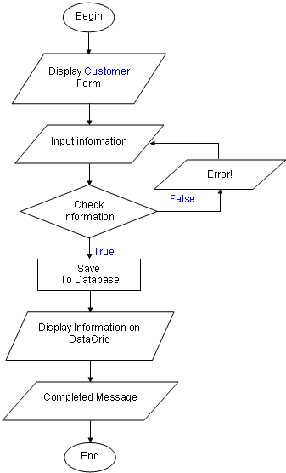
Add New Customer Algorithm
Delta Hotel
Group Four (CP200801-M)

Slide 65
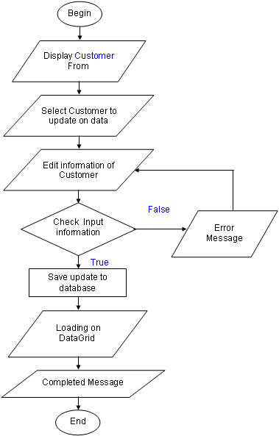
Update Add New Customer Algorithm
Delta Hotel
Delta Hotel
Group Four (CP200801-M)

Slide 66
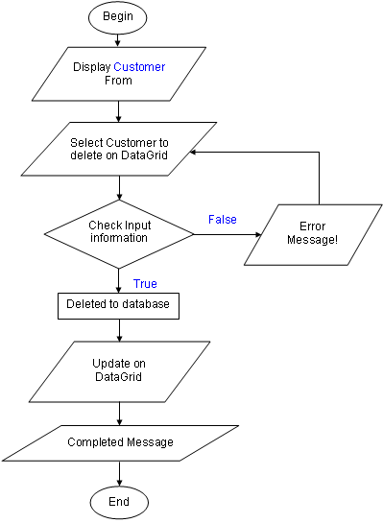
Delete Algorithm
Delta Hotel
Group Four (CP200801-M)

Slide 67
Le Hoai Thuong (CP200701-F04)
Delta Hotel
Customer Requirements Spacifications
SEARCH ROOM Algoritmt
BOOKING ROOM Algorithmts
CHECK IN Algorithmts
Change Room Algorithmt
Final Check List
Task Sheet
Group Four (CP200801-M)

Slide 68
Customer Requirements Spacifications
Delta Hotel
Clien/Project Undertaken: DeltaHotel
  List of input to the system:
    Information of the room.
    Information of the catering services.
    Information of the customer.
    Booking information.
  List of outputs expected from the system:
    List item of room.
    Search Room.
    Report for manager.
    Bill Room .
    Bill Buffet .
    List item of customer .
Group Four (CP200801-M)

Slide 69
Customer Requirements Spacifications(Cont)
Delta Hotel
  Overview of processes involved in the system:
    Room Booking process in step by step (fast and friendly)
    Order buffets process in step by step (fast and friendly)
    Check if the input of the system is valid.
    Calculate payment, print bill, and report and print report.
    Add ,delete the imformation about Food and Buffet.
    Add, delete, update the information about customers, room, services, ...
    Change User name and Password.
Hardware and software required for implementing the project:
  Client side:
    Software: OS: Windows 2000 or later, .NET Framework 1.1 or later.
    Hardware: About 400 USD or higher.
  Server side:
    Software: OS: Windows Server 2003 or later, SQL Server 2000 or higher.
    Hardware: About 800 USD or higher.
Group Four (CP200801-M)

Slide 70

Form Search Room
Delta Hotel
Group Four (CP200801-M)

Slide 71
Delta Hotel
Group Four (CP200801-M)

Slide 72

SEARCH ROOM Algoritmt
Delta Hotel
Group Four (CP200801-M)

Slide 73

Form Booking Room
Delta Hotel
Group Four (CP200801-M)

Slide 74

BOOKING ROOM Algorithmts
Delta Hotel
Group Four (CP200801-M)

Slide 75

Form Check in Room
Delta Hotel
Group Four (CP200801-M)

Slide 76

CHECK IN Algorithmts
Delta Hotel
Group Four (CP200801-M)

Slide 77

From Change Room
Delta Hotel
Group Four (CP200801-M)

Slide 78

Change Room Algorithmt
Delta Hotel
Group Four (CP200801-M)

Slide 79

Final Check List
Delta Hotel
Group Four (CP200801-M)

Slide 80
Delta Hotel
Group Four (CP200801-M)

Slide 81
Thank You !
www.DeltaHotel.com
Delta Hotel
Group Four (CP200801-M)

